Slide 1
State Machines

Slide 2
Topics to be covered
Getting Started
Terms and Concepts
Common Modeling Techniques

Slide 3
Introduction
A state machine is a behavior that specifies the sequences of states an object goes through during its lifetime in response to events, together with its responses to those events.
We use state machines to model the dynamic aspects of a system.
For the most part, this involves specifying the lifetime of the instances of a class, a use case, or an entire system.

Slide 4
Introduction
The state of an object is a condition or situation during the life of an object during which it satisfies some condition, performs some activity, or waits for some event.
We can visualize a state machine in two ways:
  by emphasizing the flow of control from activity to activity (using activity diagrams)
  by emphasizing the potential states of the objects and the transitions among those states (using statechart diagrams)
Well-structured state machines are like well-structured algorithms: They are efficient, simple, adaptable, and understandable.

Slide 5
Getting Started
In the UML, you model the dynamic aspects of a system by using state machines.
A state machine models the lifetime of a single object, whether it is an instance of a class, a use case, or even an entire system.

Slide 6
Getting Started
We use state machines to model the behavior of any modeling element, although, most commonly, that will be a class, a use case, or an entire system.
State machines may be visualized in two ways.
First, using activity diagrams, you can focus on the activities that take place within the object.
Second, using statechart diagrams, you can focus on the event-ordered behavior of an object, which is especially useful in modeling reactive systems.

Slide 7
Getting Started
The UML provides a graphical representation of states, transitions, events, and actions, as shown in below figure.
This notation permits you to visualize the behavior of an object in a way that lets you emphasize the important elements in the life of that object.

Slide 8
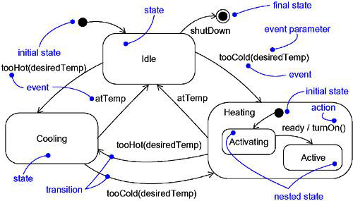
Getting Started

Slide 9
Terms and Concepts
A state machine is a behavior that specifies the sequences of states an object goes through during its lifetime in response to events, together with its responses to those events.
A state is a condition or situation during the life of an object during which it satisfies some condition, performs some activity, or waits for some event.
An event is the specification of a significant occurrence that has a location in time and space.

Slide 10
Terms and Concepts
A transition is a relationship between two states indicating that an object in the first state will perform certain actions and enter the second state when a specified event occurs and specified conditions are satisfied.
An activity is ongoing nonatomic execution within a state machine.
An action is an executable atomic computation that results in a change in state of the model or the return of a value.
Graphically, a state is rendered as a rectangle with rounded corners. A transition is rendered as a solid directed line.

Slide 11
Context
Every object has a lifetime.
On creation, an object is born; on destruction, an object ceases to exist.
In between, an object may act on other objects (by sending them messages), as well as be acted on (by being the target of a message).
In many cases, these messages will be simple, synchronous operation calls.

Slide 12
Context
In other kinds of systems, you'll encounter objects that must respond to signals, which are asynchronous stimuli communicated between instances.
The behavior of objects that must respond to asynchronous stimulus or whose current behavior depends on their past is best specified by using a state machine.
We also use state machines to model the behavior of entire systems, especially reactive systems, which must respond to signals from actors outside the system.

Slide 13
States
A state is a condition or situation during the life of an object during which it satisfies some condition, performs some activity, or waits for some event.
An object remains in a state for a finite amount of time.
For example, a Heater in a home might be in any of four states: Idle, Activating, Active, and ShuttingDown.

Slide 14
States
When an object's state machine is in a given state, the object is said to be in that state.
For example, an instance of Heater might be Idle or perhaps ShuttingDown.
A state has several parts:

Slide 15
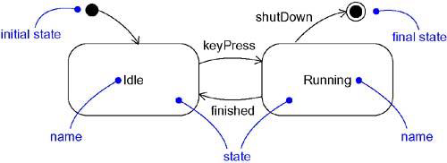
States
A state is represented as a rectangle with rounded corners as shown below:

Slide 16
1.Initial and Final States
As we can see from the above figure, there are two special states that may be defined for an object’s state machine.
First, the initial state, which indicates the default starting place of control for the state machine or sub state. It is represented as a filled black circle.
Second, the final state, which indicates that the execution of the state machine or the enclosing state has been completed. It is represented as filled black circle enclosed in a hollow circle.

Slide 17
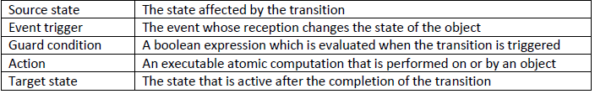
Transitions
A transition is a relationship between two states indicating that an object in one state will perform certain actions and enter another state when a specified event occurs and specified conditions are satisfied.
A transition has five parts:

Slide 18
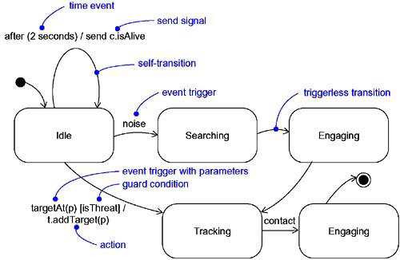
Transitions
A transition is visually represented as a solid directed line from the source state to the target state.
A self-transition is a transition whose source and target states are the same.

Slide 19
1.Event Trigger
An event is a specification of a significant occurrence that has location in time and space.
In state machines, an event is an occurrence of stimulus that can trigger a state transition.
For example, the “play button” makes the music player to change from “idle” state to “playing”.

Slide 20
1.Event Trigger
There can be triggerless transitions which are represented by a transition with no event trigger.
A triggerless transition also called a completion transition is triggered implicitly when its source state has completed its activity.

Slide 21
2.Guard Condition
A guard condition is rendered as a Boolean expression enclosed in square brackets and placed after the trigger event.
A guard condition is evaluated only after the trigger event for its transition occurs.
Therefore, it’s possible to have multiple transitions from the same source state and with the same event trigger, as long as those conditions don’t overlap.

Slide 22
3.Action
An action is an executable atomic computation.
Actions may include operation calls, the creation or destruction of another object, or the sending of a signal to an object.
An action is atomic, i.e it cannot be interrupted by an event and therefore runs to completion.
This is in contrast to an activity, which may be interrupted by other events.

Slide 23
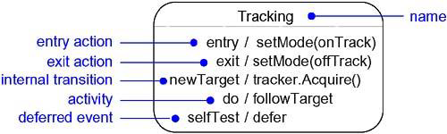
Advanced States & Transitions
UML’s state machines provide a number of advanced features that help us to manage complex behavioral models.
Some of these advanced features include entry and exit actions, internal transitions, activities and deferred events.

Slide 24
1.Internal Transitions
In state machines, a state might process certain events without leaving the current state.
Such transitions which represent events that are handled without leaving the current state are known as internal transitions.
Internal transitions are different from self transitions in the sense that events on self transitions are handled outside the current state.

Slide 25
2.Activities
After entering the state, that state might do a set of actions.
These actions are collectively known as the activity performed by a state.
In UML, activities are represented using the keyword “do”.

Slide 26
3.Deferred Events
In some situations, a state might handle certain events in another state of the object.
Such events which are postponed to be handled later in another state are known as deferred events.
In UML, deferred events are represented with the “do” action.

Slide 27
Substates
A substate is a state included in another state.
  For example, a Heater might be in the Heating and at the same time it might be in the Activating state which is a nested state in the Heating state.
In UML, we render a composite state just like a normal state, but with an optional graphic compartment that shows a nested state machine.
Substates may be nested to any level.

Slide 28
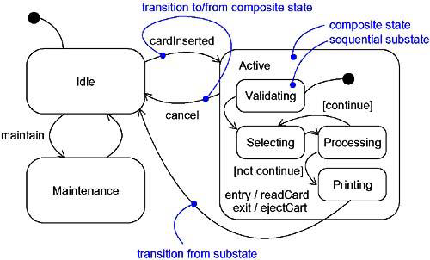
1. Sequential Substates
Consider the state machine for ATM system:

Slide 29
1. Sequential Substates
Substates such as Validating and Processing are called sequential or disjoint substates.
Given a set of disjoint states in an enclosing composite state, the object is said to be in the composite state and in only one of the disjoint substates at a time.
Therefore, sequential substates divide the state space of the composite state into disjoint states.
A nested sequential state machine may have at most one initial state and one final state.

Slide 30
2. History States
Unless otherwise specified, when a transition enters a composite state, the action of the nested state machine starts over again at its initial state.
However, there are situations in which we might want the state machine to remember the last substate that was active prior to leaving the composite state.

Slide 31
2. History States
For example, in modeling the behavior of an agent which performs unattended backup of computers across the network, we like it to remember where it was in the process if it ever gets interrupted by, for example, a query from the operator.

Slide 32
2. History States
A history state allows a composite state that contains sequential substates to remember the last substate that was active in it prior to the transition from the composite state.
In UML, a history is represented as a hollow circle with the symbol ‘H’ as shown in the below figure:

Slide 33
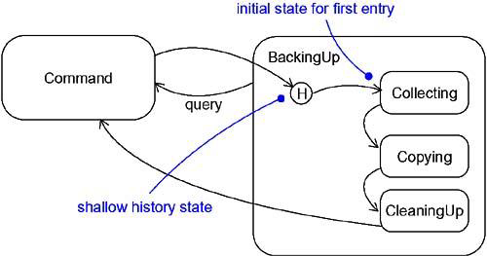
2. History States

Slide 34
3. Concurrent Substates
Concurrent substates allow us to specify two or more state machines that execute in parallel in the context of the enclosing object.
For example, in the below figure, the Maintenance mode is decomposed into two concurrent substates, Testing and Commanding, shown by nesting them in the Maintenance state but separating them from one another with a dashed line.
Each of these concurrent substates is further divided into sequential substates.

Slide 35
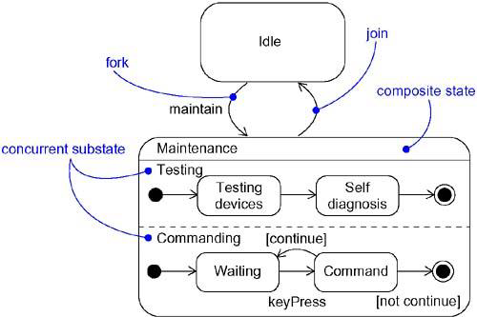
3. Concurrent Substates

Slide 36
Common Modeling Techniques
There is one modeling technique for State Machines
Modeling the Lifetime of an Object

Slide 37
Modeling the Lifetime of an Object
To model the lifetime of an object:
Set the context for the state machine, whether it is a class, a use case, or the system as a whole.
Establish the initial and final states for the object.
Consider the events to which this object may respond.
Starting from the initial state to the final state, lay out the top level states the object may be in. Connect these states with transitions triggered by the appropriate events.
Identify any entry or exit actions.

Slide 38
Modeling the Lifetime of an Object
Expand these states as necessary by using substates.
Check for the consistency of events in the object interface with the events in the state machine.
Check that all actions mentioned in the state machine are sustained by the relationships, methods and operations of the enclosing object.
Trace through the state machine, either manually or by using tools, to check it against expected sequences of events and their responses.
After rearranging, again check it against the expected sequences to ensure that you have not changed the object’s semantics.

Slide 39
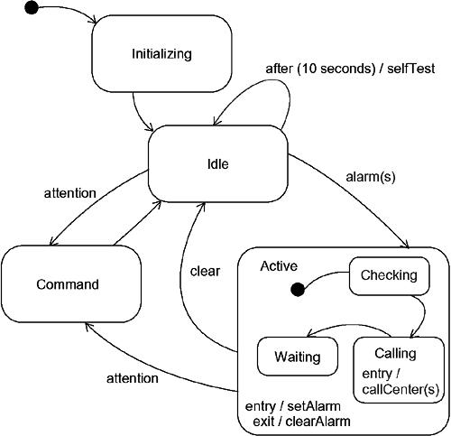
Modeling the Lifetime of an Object

